Slide 1

Affordable & Effective remote monitoring of
Diabetes, Epilepsy & Respiratory SAAS Platform

Slide 2
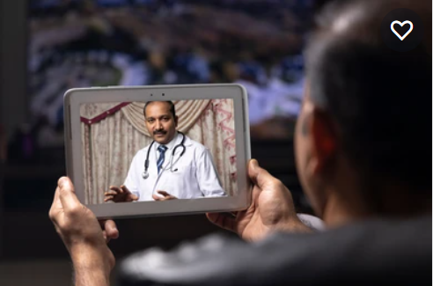

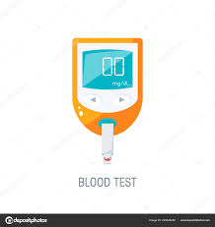
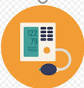
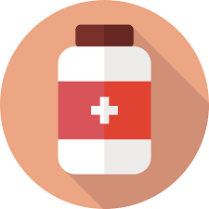
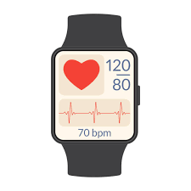
Remote Patient Monitoring & Telehealth SAAS Platform built by Doctors, Patients and Family Members
Affordable & Effective
Digital Platform Integrating Medical Devices, Patients & Providers

Slide 3
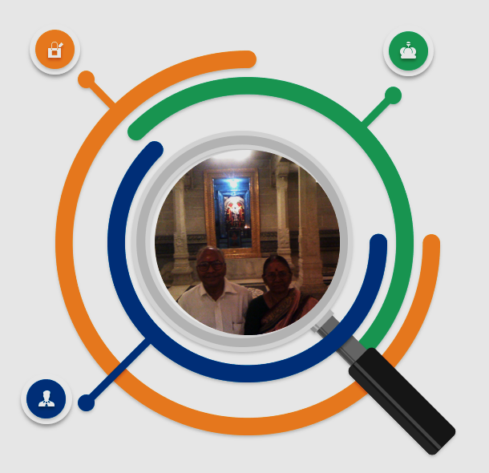




Issues
Family
How to I avoid emergencies to my family?
Can I get regular health stats for my family?
Can I help them remotely
Patients
How to Improve my Health & Wellness?
How to reduce my medical bills?
How reduce my dependency on others?
How to reduce long waiting time at Hospitals?
How to reduce my risk of pandemic exposure
Providers
How reduce patients revisit to Hospitals?
How to Increase my patient base?
How do I get to know patient’s
Life style? Adherence, Vitals stats?

Slide 4

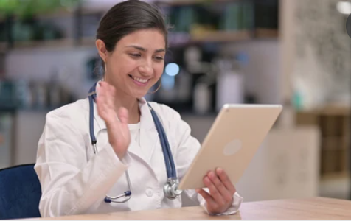
What’s it for doctor
Increased touch points for the doctor with the patient – planned/adhoc video consultation between clinic visits
Additional consistent revenue without compromising regular OPD consultations
Integrated platform – obviates installation and investment in multiple softwares
Protection of vulnerable patients through telehealth
Visualization of the patients’ data through user friendly dashboards enabling improved patient management
Meet the new norms of future market needs through of Remote Patient Monitoring (RPM) & Telehealth
Mobile and Cloud born and ready application at no cost
Flexibility of delegating to residents for screening and schedule adhoc/planned Video conferencing
No need for any load software, server, storage and security
Doctor

Slide 5

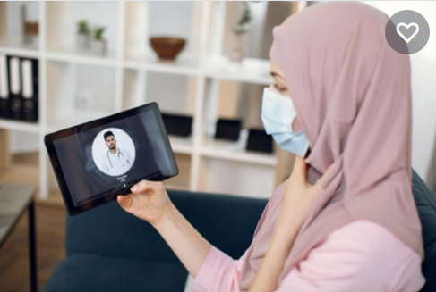
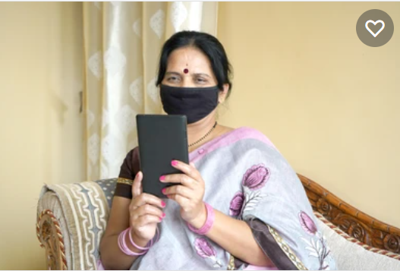
What’s it for Patient
What’s in it for the patient
Actively participate in his/her health care management
Track the health/wellness progress which acts as a motivator for owning up one’s health
No need to frequently visit the hospital
Can monitor the defined parameters and automatically post it to the doctor’s dashboard
Improved adherence to drugs, consistency in following lifestyle changes controls the disease and reduces the complications
Patients can select doctors of their choice
Medical records are readily available for review by other doctors in same/different geography
Designated family members can actively participate in the disease management of their parents or relatives
Designated family members at remote locations get regular alerts on health of the dependent
SOS to doctors is just a click away
Patient

Slide 6




Device partners
BMI
BP
Glucose
Spirobank
Oxi
PFT + SPO2 + BPM
Partnership with MIR Italy, offering FDA/CE approved devices to measure
Seizure Detection
Confidential pitch deck, Copyright & Property of www.AmeraldCare.com. Kindly refrain from sharing, copying and transmitting. Product & Services are Patent Filed

Slide 7
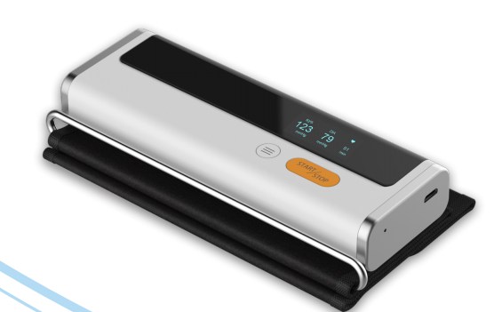
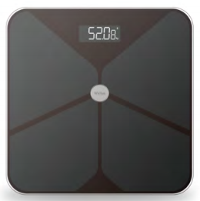
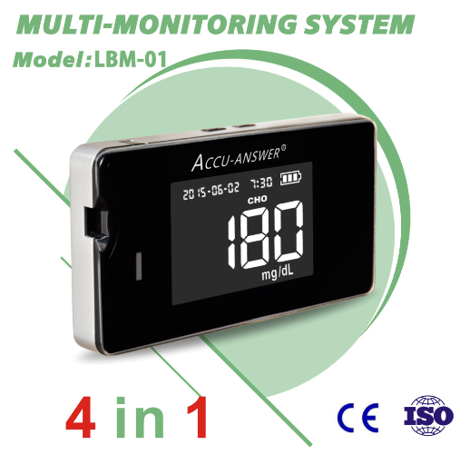
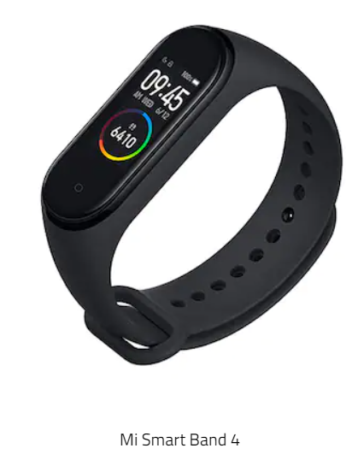

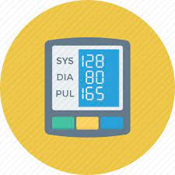


Device Details
BP Monitor
BMI
Glucometer
Wearable

Slide 8
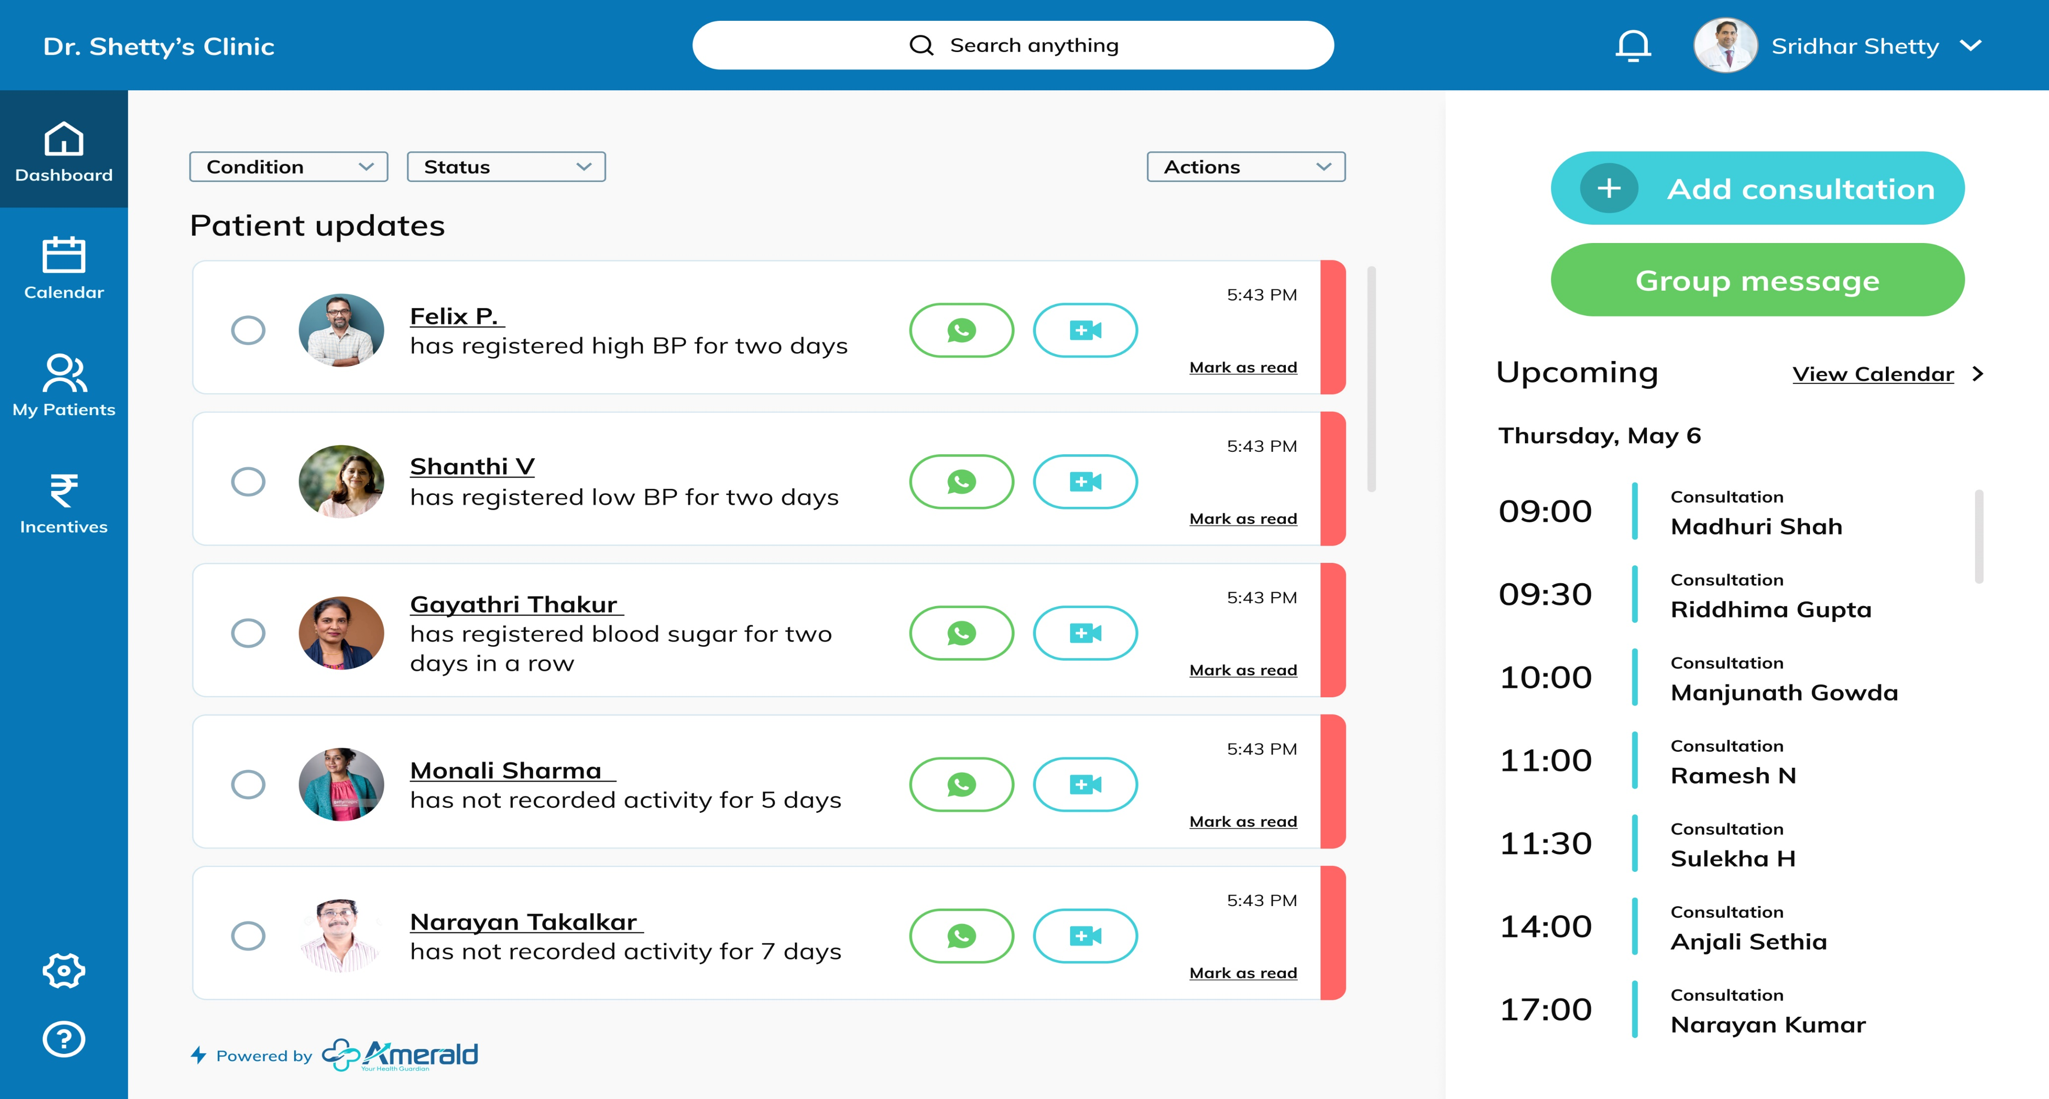
Doctor’s Dashboard

Slide 9
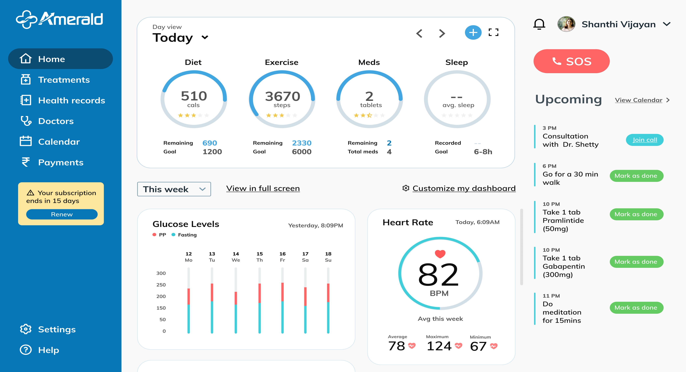
Patient’s Dashboard

